Slide 1


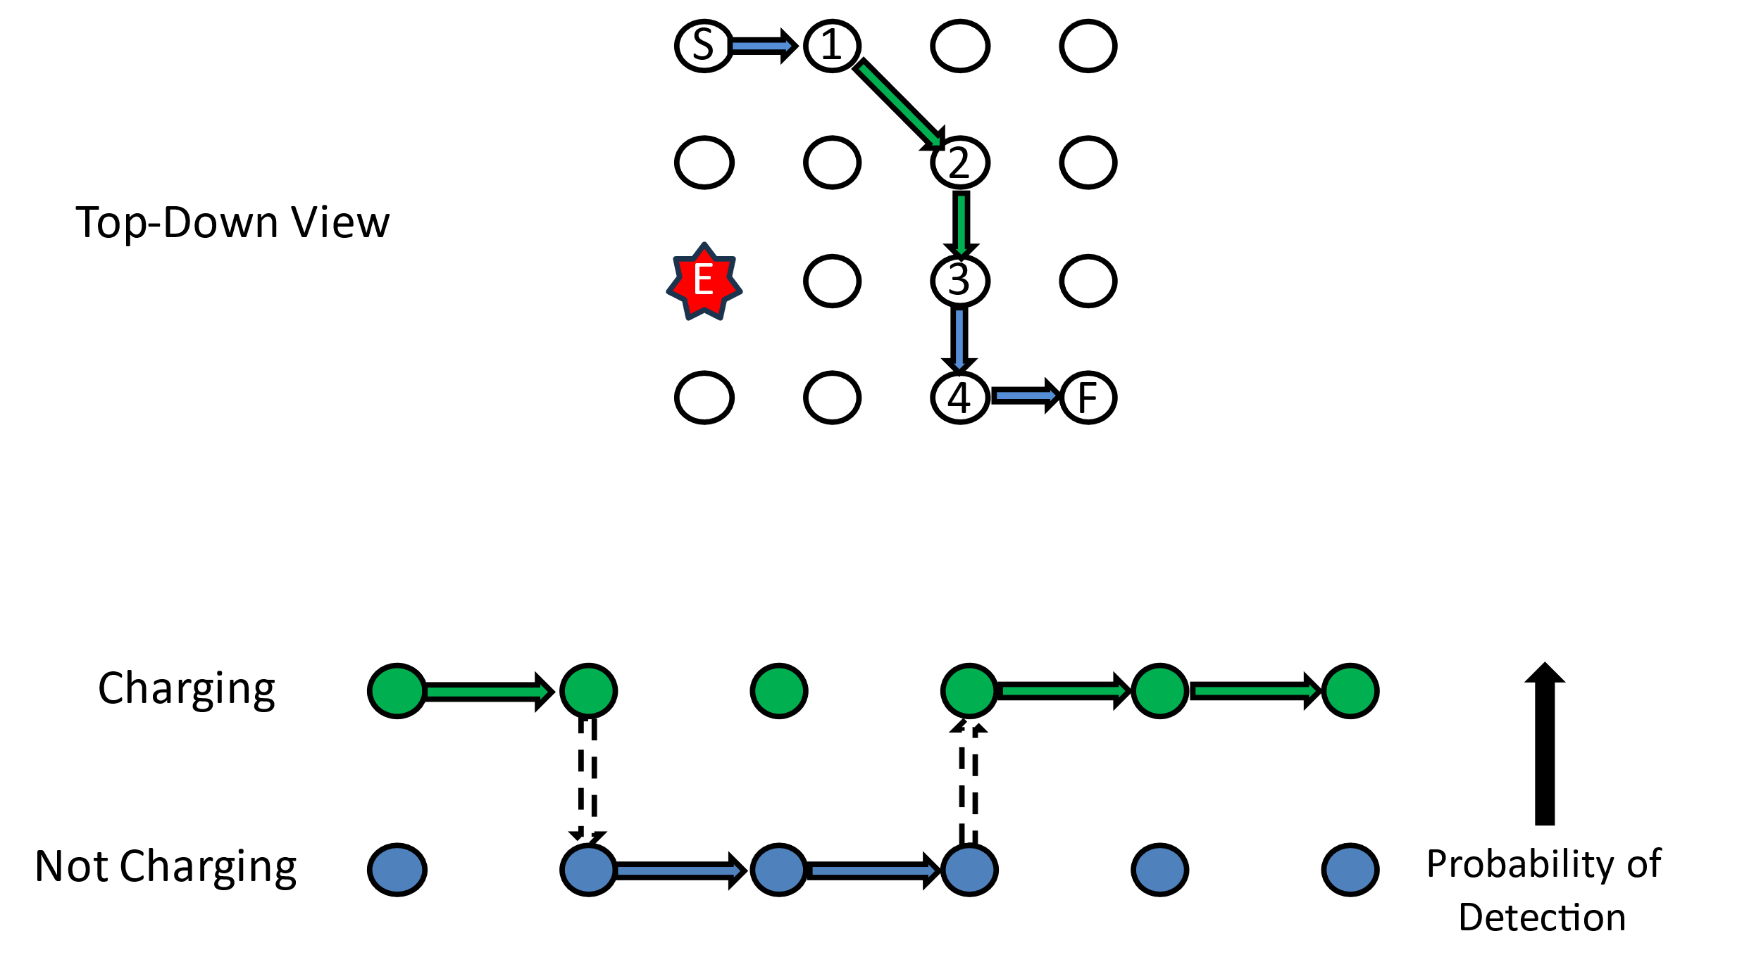
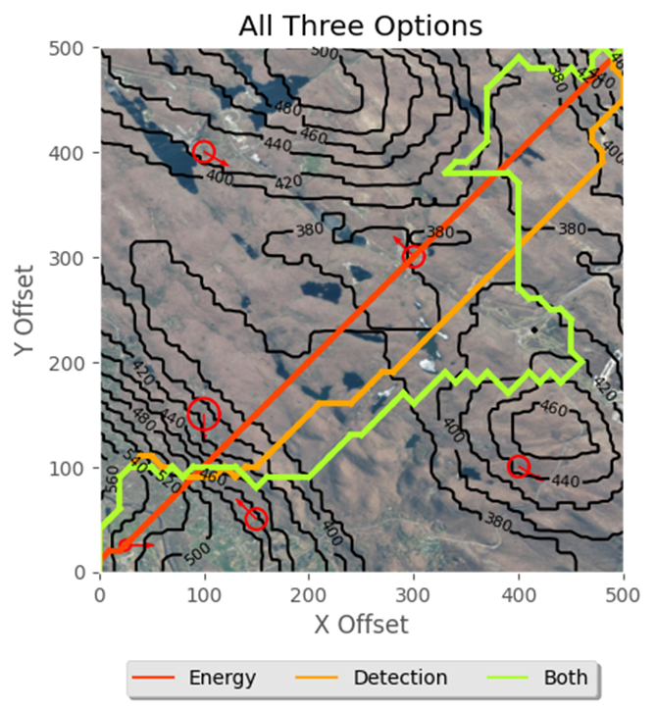
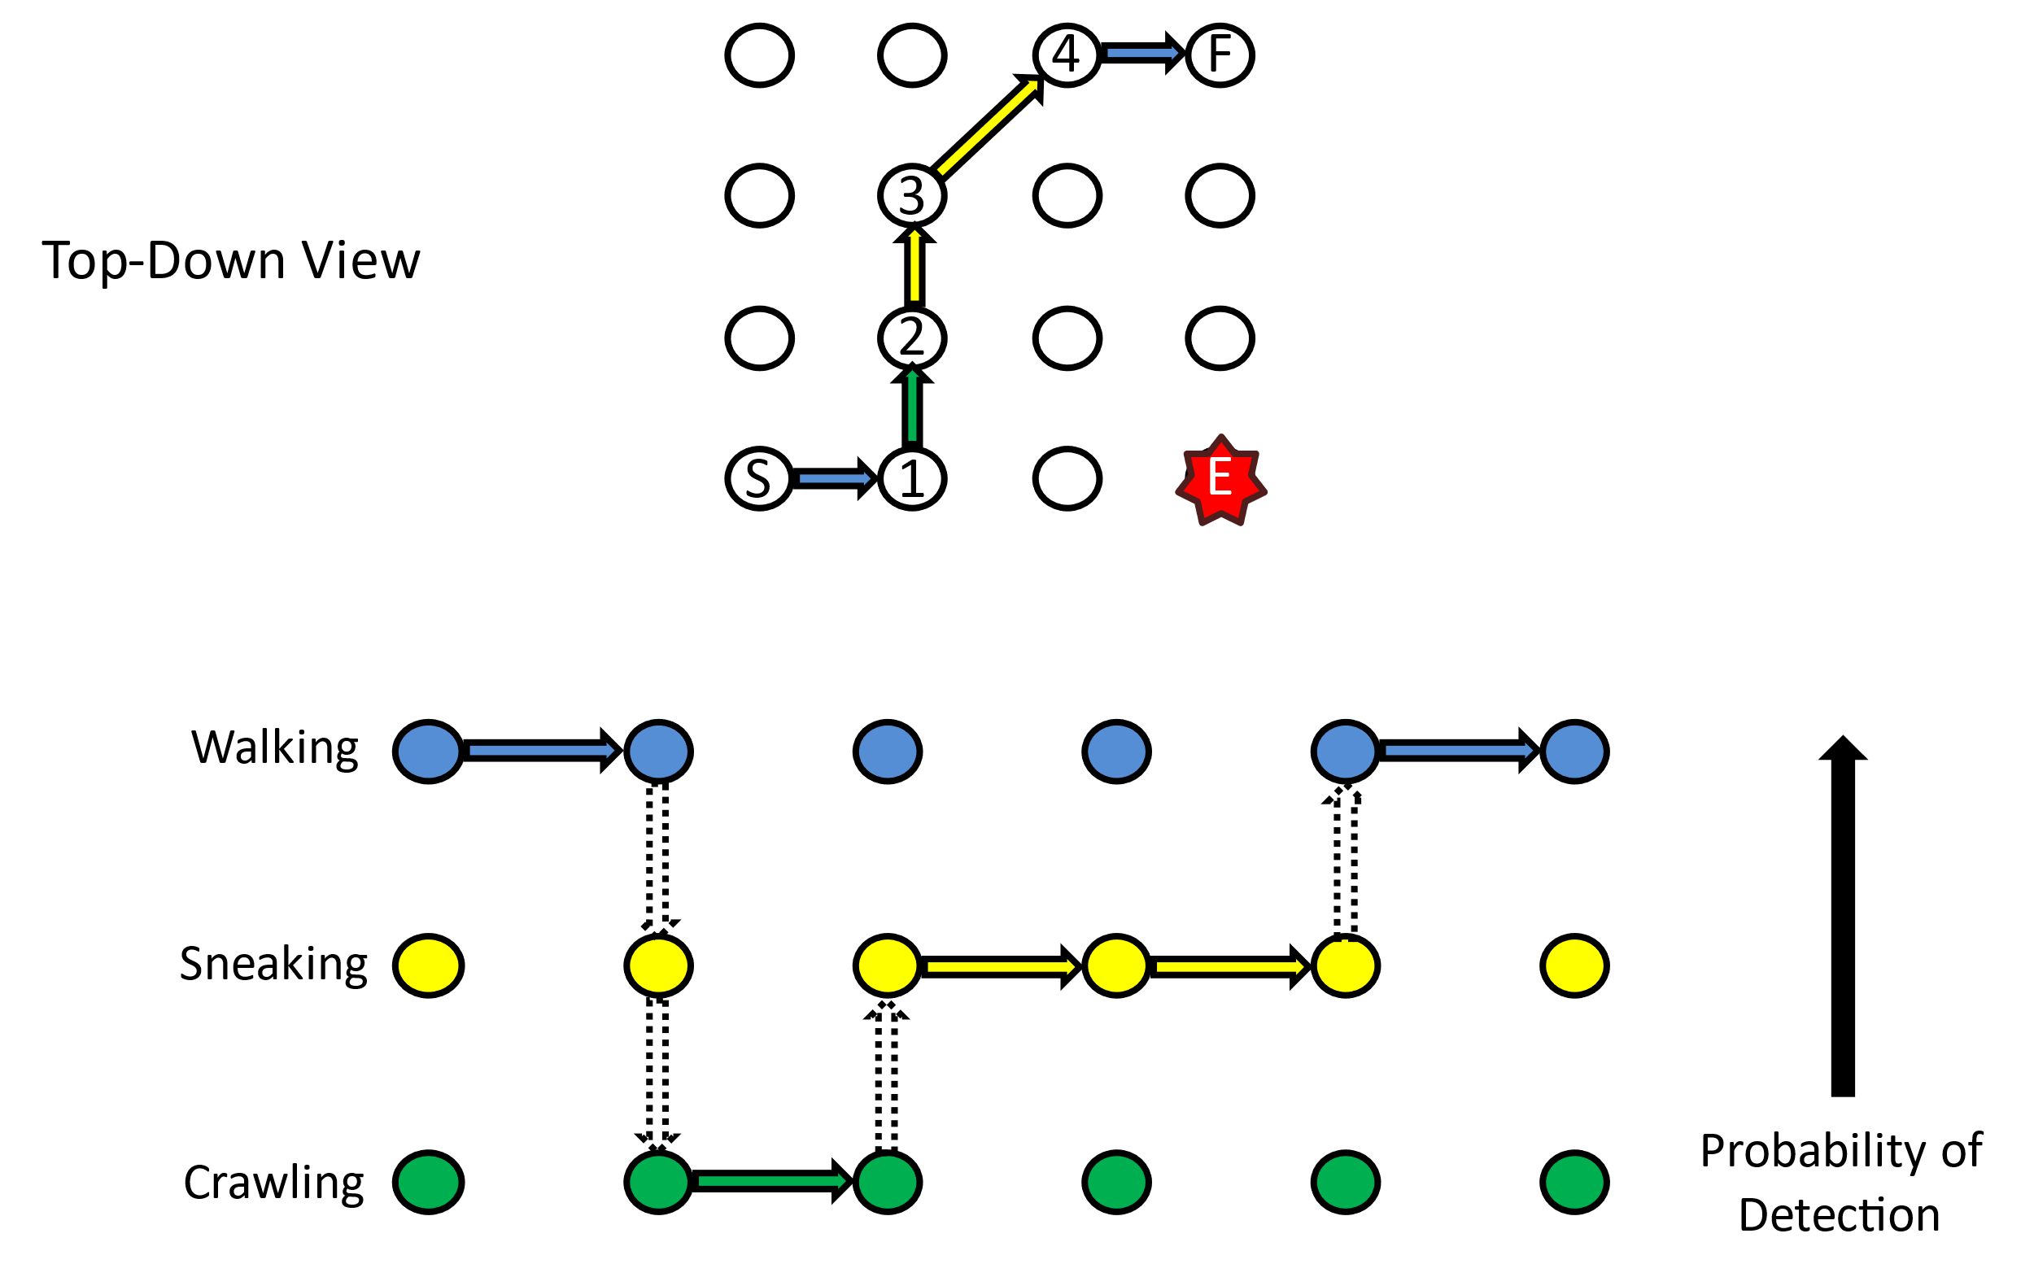




2024 Fall Undergraduate Research Expo
Optimal Tactical Routing for Unmanned Ground Vehicles
Advisors: LTC James Grymes, COL Corey James, and Dr. Robert Jane
Presenter: CDT Jacob Hyatt
Problem Statement
Military autonomous vehicles, particularly electric or hybrid variants traversing terrain, are unlikely to complete their specific mission unless they can avoid detection and manage their onboard energy sources. These two critical criteria are often at odds with one another. We aim to create a path planning tool for unmanned ground vehicles, while minimizing the risk of detection and expended energy.
Previous Work
Previous work focused on creating an optimal path for a human in a contested environment. We allowed the human to have three different forms of movement that had different effects on the likelihood of detection as seen in Figure 1. We leveraged satellite-derived vegetation data, introduced multiple enemies with varied capabilities, and enhancing the probability models for more realistic assessments. Leveraging these projections, we employed a modified A* algorithm to plan routes that meet mission time constraints while minimizing detection risk.
Fig 1. Previous methods for human evader
Methodology
Utilizing a Digital Elevation Model (DEM) and Normalized Difference Vegetation Index derived from Landsat 8 imagery we create an accurate picture of the area of operations. We emplace enemies in various locations and calculate the edge weights for energy consumption and detection likelihood. We then utilize Gurobi to run the multi-objective function subject to realism constraints.
Fig 2. Overview of methodology
Optimization Function
Detection Cost: Utilizes visual and audio detection functions built for humans but adapted for unmanned ground vehicle. Audio detection leverages the probability of being heard over the background noise of the area of operations. Visual detection utilizes line of sight and the total space that the UGV takes up in a human’s eye at a distance.
Energy Cost: Drive train simulation of unmanned ground vehicle Calculates energy in kJ that it takes to move from one node to another. Vehicle has regenerative braking and an onboard 5kW generator.
Optimization Function: $α$ and $β$ can be changed to alter the weight of detection or energy cost. We minimize the total likelihood of detection when an arc is taken plus the scaled total energy cost of the path taken
Eq 1. Multi-Objective optimization function
Results
Fig 3. Routes with different objective weights
Conclusion
The generated paths allow for three distinct options for a commander to choose from. The path solely minimizing energy consumption goes directly through an enemy, while the path minimizing solely detection consumes more energy and takes a more round about path. Allowing for the customization of weights for both detection and energy consumption allows for a pareto frontier of decisions a commander can make.
References
Kendall, Thomas P., Daniel T. Killian, and Matthew J. Koch. "Optimized Tactical Route Planning." Military Operations Research Journal 28, no. 4 (2023): 5-21.

